Slide 1
SOEN 343
Anti-patterns and refactoring

Slide 2
Refactoring definition
It is a software maintenance activity for restructuring code design without changing its external behavior
The purpose of refactoring is not to fix bugs, but to improve design quality and control technical debt
Given its behavior-preserving nature, refactoring does not add new functionality to the system, but ease the further addition of new functionality
It is a key activity of XP and Agile methodology

Slide 3
When to perform refactoring
Refactoring must be interleaved with coding activities
When using iterative or incremental development, a major refactoring stage should precede the beginning of the development of a new build. This will remove slight design problems and ease the addition of further functionality.

Slide 4
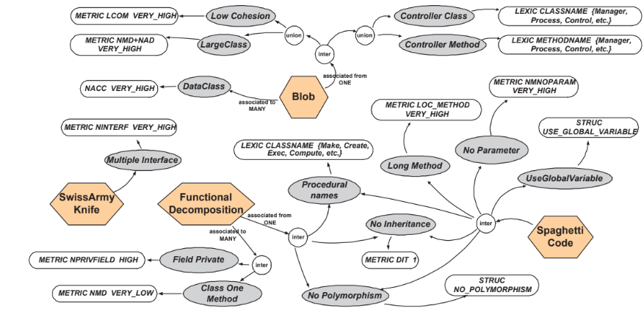
Refactoring to remove anti-patterns
When performed properly, it can help to detect and remove poor-design choices or anti-patterns
Anti-patterns hinder software evolution
They are typically manifested in the form of code smells
Taxonomy of design defects (hexagons are anti-patterns, gray ovals are code smells, and white ovals are properties. Moha et. Al 2009

Slide 5
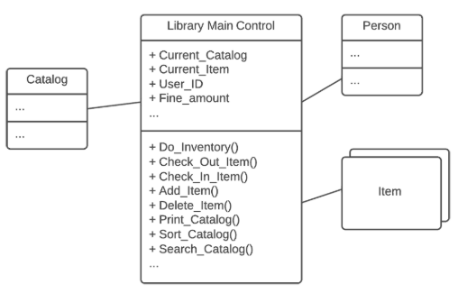
Example of anti-pattern: Blob
https://sourcemaking.com/antipatterns/the-blob
Notes:
In the literature code anti-patterns are indicators of software design shortcomings
They are associated with an explicit set of refactoring strategies
How and to which extent can reflect how maintainable a system is?
Large controller class, low cohesion, associated with simple, data-object classes…

Slide 6

Impact of anti-patterns
Anti-patterns have a negative impact in on code understandability
Abbes et al. [CSMR ‘11]
Anti-patterns are related to change-proneness
Khomh et al. [ESE ‘12]

Slide 7
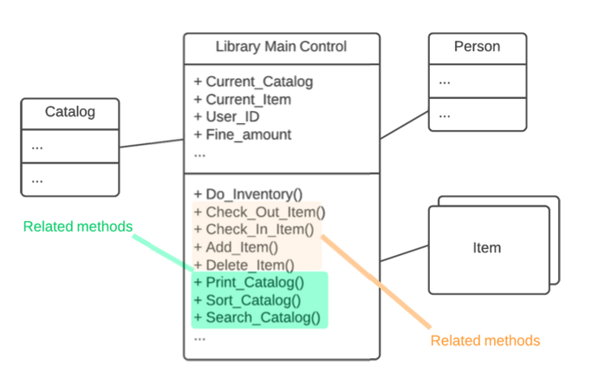
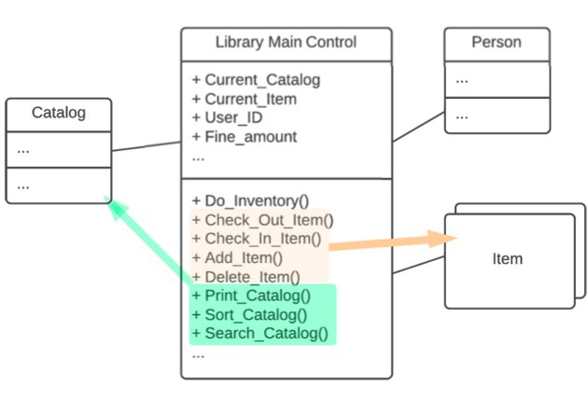
Refactoring is used to improve design quality and to combat system aging

Slide 8
Refactoring: drawbacks
Cost Overhead: Refactoring is maintenance activity and therefore will incur extra cost in form of time, effort, and resource allocation. However, in the long term, its benefits are greater than its overhead. Static analysis tools, refactoring tools and testing tools will also diminish the refactoring overhead
Requires Expertise: Refactoring requires some expertise and experience and considerable effort in going through the process, especially if proper testing is involved. However, this overhead can be minimized by using refactoring tools and automated testing such as with a unit testing framework.

Slide 9
Selection of refactorings

Slide 10
Renaming method
The name of a method does not reveal its purpose. Refactor it by changing the name of the method.
This applies to classes, interfaces and any other code entities.
int getInvCdtLmt(){
…
}
int getInvoiceableCreditLimit(){
…
}

Slide 11
Extract variable
Problem: You have an expression that is hard to understand.
Solution: Place the result of the expression or its parts in separate variables that are self-explanatory.
void renderBanner() {
if ((platform.toUpperCase().indexOf(“Win") > -1) &&
(browser.toUpperCase().indexOf("IE") > -1) &&
wasInitialized() && resize > 0 ) {
// do something
}
}
void renderBanner() {
final boolean isMacOs = platform.toUpperCase().indexOf(“Win") > -1;
final boolean isIE = browser.toUpperCase().indexOf("IE") > -1;
final boolean wasResized = resize > 0;
if (isMacOs && isIE && wasInitialized() && wasResized) {
// do something
}
}

Slide 12
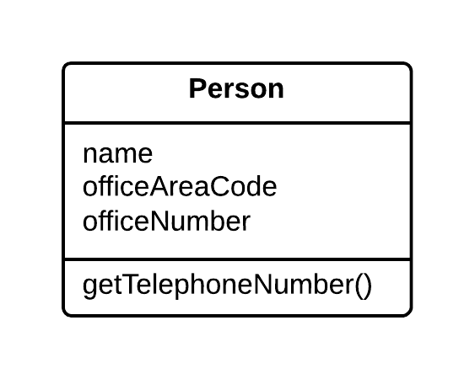
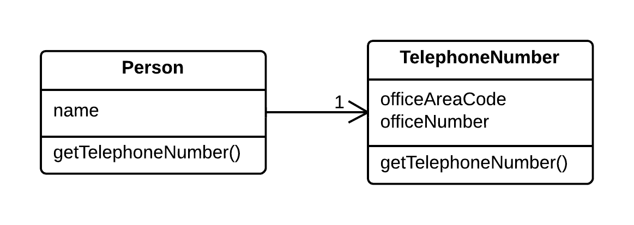
Extract class
Problem: When one class does the work of two, awkwardness results. (SRP principle)
Solution: Instead, create a new class and place the fields and methods responsible for the relevant functionality in it

Slide 13
Introduce parameter object
Encapsulate attributes that logically go together to a new parameter object to remove a long parameter list
Customer
Customer
amountInvoiced (start Date, end Date)
amountReceived (start Date, end Date)
amountOverdue (start Date, end Date)
amountInvoiced (d DateRange)
amountReceived (d DateRange)
amountOverdue (d DateRange)

Slide 14
Extract Method
You have a code fragment that can be grouped together.
Move this code to a separate new method (or function) and replace the old code with a call to the method.
void printOwing() {
printBanner();
// Print details.
System.out.println("name: " + name);
System.out.println("amount: " +
getOutstanding());
}
void printOwing() {
printBanner();
printDetails(getOutstanding());
}
void printDetails(double outstanding) {
System.out.println("name: " + name);
System.out.println("amount: " + outstanding);
}

Slide 15
Decompose conditional
Useful when you have a complex conditional (if-then/else or switch)
Solution: Decompose the complicated parts of the conditional into separate methods
if (date.before(SUMMER_START) || date.after(SUMMER_END)) {
charge = quantity * winterRate + winterServiceCharge;
}
else {
charge = quantity * summerRate;
}
if (isSummer(date)) {
charge = summerCharge(quantity);
}
else {
charge = winterCharge(quantity);
}

Slide 16
Replace method with method object
You have a class with a long method which local variables are too intertwined that you cannot apply extract method
Order
PriceCalculator
double price ( ) {
double primaryBasePrice
double secondaryBasePrice
double ternaryBasePrice
//LONG METHOD
}
double primaryBasePrice
double secondaryBasePrice
double ternaryBasePrice
Order
price()
1
price()
compute()
Return new PriceCalculator.compute()

Slide 17
Inline class
When a class is doing too little, it is better to move its content to a related class, to keep design size small
Note that you need to update the references to the methods exposed by the inlined class to the target class
A
B
methodA1 ();
methodA2();
methodA3();
methodB1() { …}
A
B
methodA1 ();
methodA2();
methodA3();
methodB1() { …}
methodB1() { …}

Slide 18
Replace inheritance with delegation
Problem: You have a class that uses a small portion of the methods inherited for her parent class
Solution: replace the inheritance relationship by delegating the functionality used from the parent class
A
getName() method2() method3()
B
A
getName() method2() method3()
B | 1
-A
getName()
this.A.getName()

Slide 19
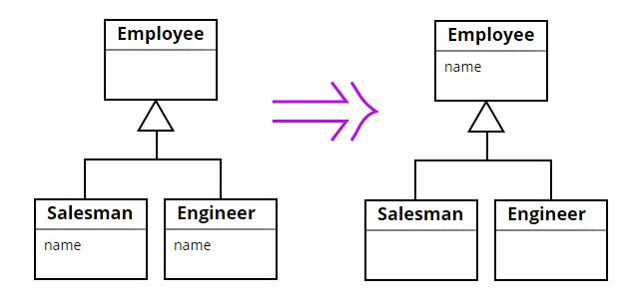
Pull up field/method
Two subclasses have the same field. Refactor it by moving the field to the superclass.

Slide 20
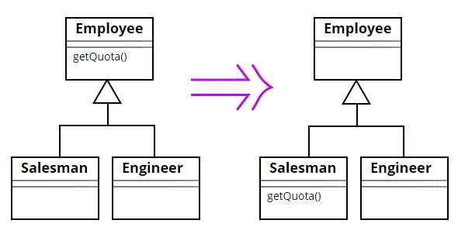
Push down method/field
Behavior on a superclass is relevant only for some of its subclasses. Refactor it by moving it to those subclasses.

Slide 21
Collapse hierarchy
If the number of children of a class is equal to one, you should consider pull up all methods and attributes to the abstract class, and remove the child.
abstract Employee
Employee
attribute 1;
attribute 1;
abstract method1 ();
abstract method2();
method1() { …}
method2() { …}
Salesman
Salesman
method1() { …}
method2() { …}
method1() { …}
method2() { …}

Slide 22
Refactoring practice
Some refactorings are controversial
Some refactorings are arguably not improving code quality
Some refactorings can in fact be counter-productive when applied blindly, especially in incremental or iterative development, where design is evolving
Have your team adopt a set of refactorings to be applied, and make sure that refactorings are applied in a productive manner
Apply in combination with the application of design patterns
Use refactoring tools to automate changes, e.g. Eclipse, Intelli J, and JUnit testing framework
For delivery 2 and 3, you will have to report on the refactoring operations applied to your project

Slide 23
Refactoring in the project
A refactoring operation should be done before you start working on a new release
Establish a list of potential refactoring targets:
Code inspections
Discussions among developers
Code review tools
Select actual refactoring targets from the list of potential refactoring operations:
There may be very numerous potential targets.
Select only a few actual targets that are likely to have the most positive effects
Tests should be available for all actual refactoring targets

Slide 24
Refactoring in the project (contd.)
For each actual refactoring target:
Assess the completeness of the tests. Write more tests if necessary
Run the tests
Determine what transformation you will apply based on the literature of refactoring, and (anti)patterns.
Apply the refactoring on the code
Run the tests

Slide 25
References
Source Making. Refactoring. http://sourcemaking.com/refactoring
Martin Fowler, Kent Beck, John Brant, William Opdyke, Don Roberts. Refactoring: Improving the Design of Existing Code. Addison-Wesley Professional, 1999. ISBN-13: 978-0201485677.
Martin Fowler. Refactoring.com.

